Slide 1
LinkedIn Crawler:
Sprint 4
Scrum At Me Bro

Slide 2
The Product and Value
The LinkedIn Crawler is a collaboration project between three teams
The goal is to create an application that GSU students can use to locate current and former GSU students using several different search criteria
LinkedIn.com will be the repository with which we extract query results from
The output of the application will be a csv document which will contain the search results

Slide 3
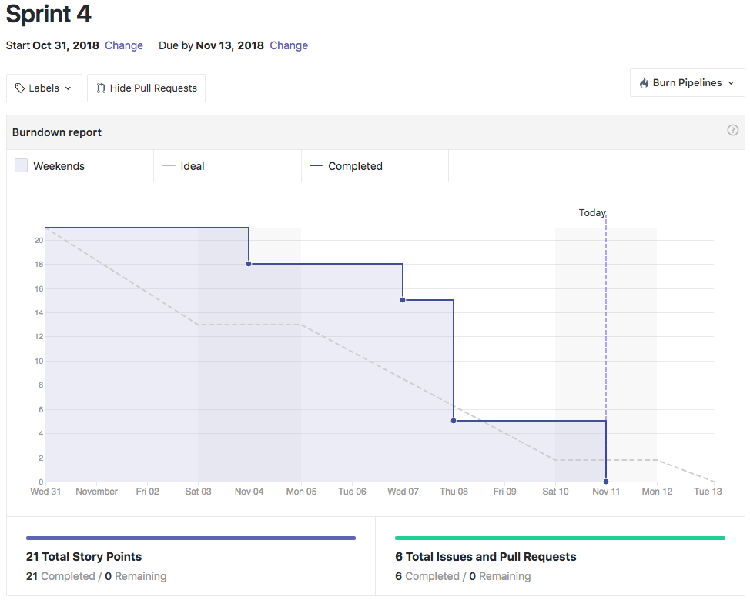
Sprint 4 BurnDown

Slide 4
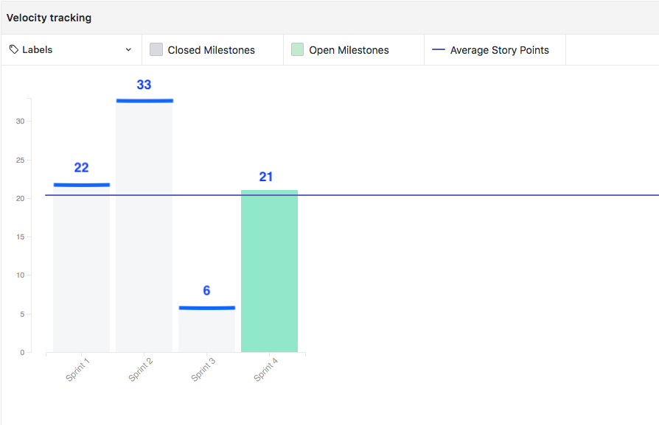
Sprint 4 Velocity

Slide 5
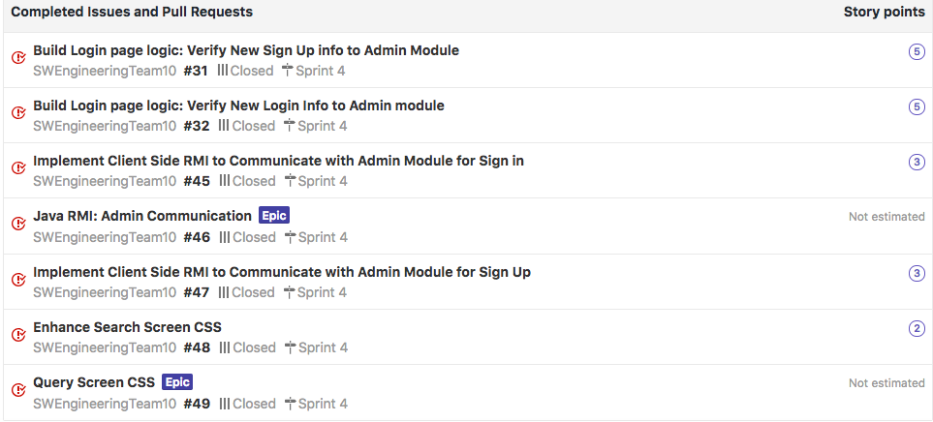
Completed Stories

Slide 6
Backlog
Sending query information to the backend module
Receiving notification from backend of result file location
Adding a processing spinner to the GUI
End to end testing

Slide 7
Test Scenario #1: Validate the “Happy” paths
User wants to open the application, either sign in or create new login information, then enter search criteria to be sent for processing. Once the user is done, they want to be able to close the application.
When program is initiated, the login screen activates
When the user enters login information and presses “Sign In” button, login credentials are shown in the command window
When user presses “Sign Up” button, the signup window activates
When user presses “Sign Up” button, the login window closes
When user enters search criteria on the Search page, then hits “Search” button, the information is retrieved in the command window
When the user hits the “Cancel” button on the search page, the application closes

Slide 8
Test Scenario #2: Validate error messaging:
User needs to be made aware if they improperly logs in, puts bad criteria into the new sign-up window, or enters bad information into the search page
If user enters no data in the login window, then presses the “Sign In” button, an error is displayed to the user prompting them to enter credentials
If user enters credentials in the login window, then presses the “Sign Up” button, an error is displayed and the user is prompted to hit the “Sign In” button or clear the credentials
If user goes to the sign up window and enters numbers in the “First Name” field, an error is displayed and the user is prompted to enter only alpha characters
If user goes to the sign up window and enters numbers in the “Last Name” field, an error is displayed and the user is prompted to enter only alpha characters
If user goes to the search window and enters numbers in the “First Name” or “Last Name” field, an error is displayed and the user is prompted to enter only alpha characters

Slide 9
Questions?

